Slide 1
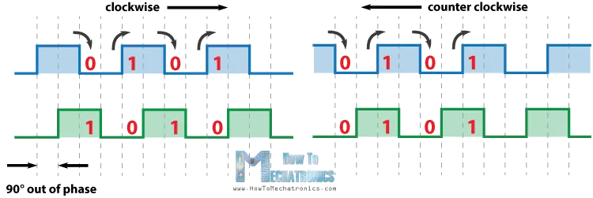
Rotary encoder but we read the pulse during the rising edge so we can use capacitor for debouncing
CLK
B
DT
A
previousStateCLK = digitalRead(CLKpin);
currentStateCLK = digitalRead(CLKpin);
if (currentStateCLK != previousStateCLK) {
{
if (digitalRead(DTpin) != currentStateCLK) {
counter2 ++;
}
else {
counter2 --;
}
}
}

Slide 2
Read pin value
Condition for detection: previous state == LOW && digitalRead(Pin) == HIGH
Switch to stand by condition: previous state == HIGH, digitalRead == LOW => previous state = LOW
(but what if there is multiple pulse during HIGH to LOW

Slide 3
currentState_FSW2 = digitalRead(footSwitch2);
if (lastState_FSW2 == HIGH && currentState_FSW2 == LOW) {
pressedTime_FSW2 = millis();
}
else if (lastState_FSW2 == LOW && currentState_FSW2 == HIGH) {
releasedTime_FSW2 = millis();
long pressDuration_FSW2 = releasedTime_FSW2 - pressedTime_FSW2;
if ( pressDuration_FSW2 < SHORT_PRESS_TIME_FSW2 ) {
Serial.println("A SHORT press is detected");
foot_switch2();
}
if ( pressDuration_FSW2 > LONG_PRESS_TIME_FSW2 ) {
Serial.println("A long press is detected");
}
}
lastState_FSW2 = currentState_FSW2;
currentState_FSW1 = digitalRead(footSwitch1);
if (lastState_FSW1 == HIGH && currentState_FSW1 == LOW) {
pressedTime_FSW1 = millis();
}
else if (lastState_FSW1 == LOW && currentState_FSW1 == HIGH) {
releasedTime_FSW1 = millis();
long pressDuration_FSW1 = releasedTime_FSW1 - pressedTime_FSW1;
if ( pressDuration_FSW1 < SHORT_PRESS_TIME_FSW1 ) {
Serial.println("A SHORT press is detected");
foot_switch1();
}
if ( pressDuration_FSW1 > LONG_PRESS_TIME_FSW1 ) {
Serial.println("A long press is detected");
}
}
lastState_FSW1 = currentState_FSW1;

Slide 4
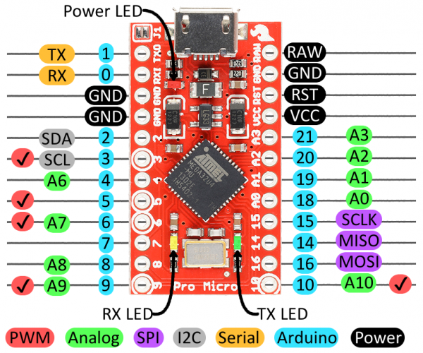
Rotary encoder 2
Big red button external interrupt
Rotary encoder 1
Foot SW 1
Foot SW 2

Slide 5
EEPROM
Store bitmap array in EEPROM
const unsigned char POWERPOINT_logo [] { data }
const unsigned char POWERPOINT_logo [] { data }
void testdrawbitmap_POWERPOINT(void) { //call this function to draw bitmap
display.clearDisplay();
display.drawBitmap((display.width() - LOGO_WIDTH ) / 2,(display.height() -LOGO_HEIGHT) / 2,
POWERPOINT_logo, LOGO_WIDTH, LOGO_HEIGHT, 1);
display.display();
}

Slide 6
Diagram
Use encoder to choose program for work
Push encoder
Use encoder to choose program for games
Arduino
Word
Excell
Powerpoint
Profile 4
Sifu
Valorant
Farcry 4
Profile 7
Profile 8

Slide 7
Requirements
Display frogram bitmap on OLED using bitmap data from EEPROM
Turn encoder to choose profile, push encoder to change between profile groups
Sifu
Valorant
Farcry 4
Arduino
Word
Excell
Powerpoint

Slide 8
Arduino Ctrl = C Ctrl = V
Word Ctrl+E Ctrl+Alt+S
Excell Shift + Left arrow Shift + Right arrow
Powerpoint Ctrl+Z Alt+N
Sifu W + W + LMB S + W + RMB
Valorant V ,
Farcry 4 Shift C
Forza horizon 4 P T
Edge alt + left arow

Slide 9
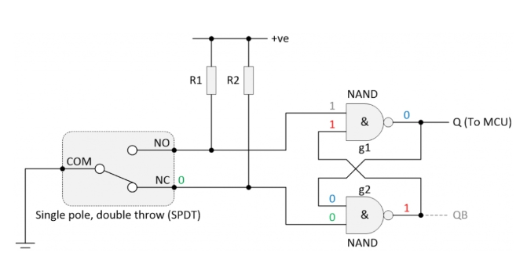
Hardware debounce

Slide 10
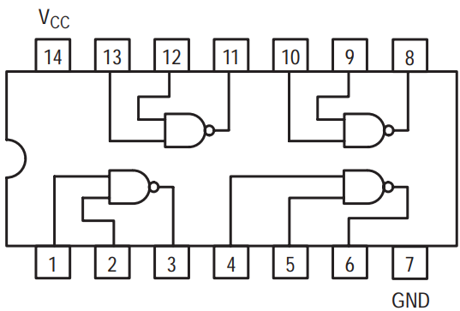
NO
NC
Q
Q
NO
NC

Slide 11
S
R
S
R

Slide 12
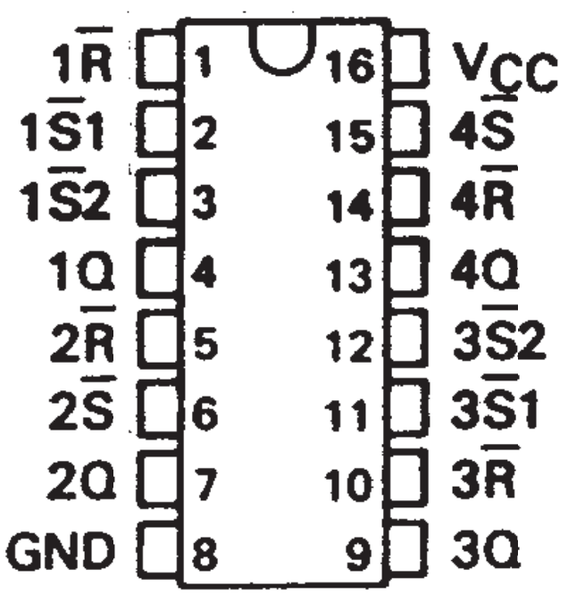

Slide 13
Input1
Input2
Input3
Input4
SR latch + pullup
Input1
Input2
Input3
Input4
Input5
Input6
GND
Vcc
Coltroller side
Leg side
NO1
NC1
NO2
NC2
NO3
NC3
SR latch
SW 1
SW 2
SW 3
SW 1
SW 2
SW 3
SW 4
SW 5
SW 6

